Slide 1
Variational Autoencoders & Applications
by Student: Christos KORMARIS
Supervisor Professor: Dr. Michalis TITSIAS

Slide 2
Outline
Introduction
Variational Inference
Benefits of Variational Inference & Drawback of VAEs
The Variational Lower Bound (ELBO)
Optimizing the ELBO
The Reparameterization Trick
Calculating the update rules of the weights of the encoder and the decoder
The Whole VAE Process
The TensorBoard
K-NN Missing Values Algorithm
VAE Missing Values Algorithm
Datasets
Experimental Results

Slide 3
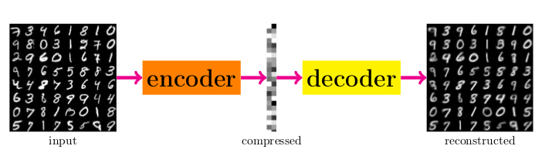
Introduction
A variational autoencoder is a method that can produce artificial data which will resemble a given dataset of real data. Why? For many reasons, such as to increase the size of datasets.
For instance, if we want to produce new artificial images of cats, we can use a Variational Autoencoder algorithm to do so, after training on a large dataset of images of cats.
The input dataset is unlabeled. We are not interested in classifying the data to a specific class, but we would rather be able to learn the most important features or similarities among the data.
A Variational Autoencoder is sequence of two neural network one after the other. The first neural network is called the encoder. The second neural network is called the decoder.
The encoder and the decoder are trained simultaneously.
The VAE runs dimensionality reduction on the initial data, by compressing them into latent variables.

Slide 4



Variational Inference
First, we want to calculate the encoder, i.e. we want to estimate:
Each term can be represented as follows:
We can calculate the normalizing constant (aka evidence) by marginalizing out the latent variables Z:
However, calculating this integral requires exponential time, because the distribution of the latent variables Z is continuous. We will use a method called variational inference.

Slide 5
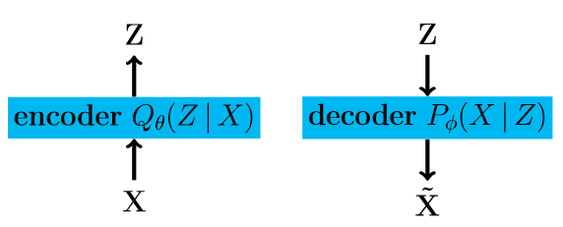
Benefits of Variational Inference
& Drawback of VAEs
Benefits of Variational Inference
Intractability: The calculation of the term P(X) is intractable and so is the term P(Z|X). Thus, the Expectation-Maximization (EM) algorithm and other similar algorithms cannot be used. This is where the variational inference comes in to offer a solution.
Large datasets: Optimization algorithms that train on the whole set of data on each iteration (e.g. batch gradient descent) are too costly. With variational inference, the parameters are updated using small mini-batches or even single data points (e.g. stochastic gradient descent).
Main Drawback of VAEs
Blurry Images: The reason remains to be researched.

Slide 6
The Variational Lower Bound (ELBO)
The whole term L(X, Q) is called Variational Lower Bound or ELBO.
The term E [logP φ (X|Z)] is called reconstruction cost.
The term D[Q θ (Z)||P (Z)] is called penalty or regularization term.
The penalty term ensures that the explanation of the data Q(Z|X) ≈ Q(Z) doesn’t deviate too far from the beliefs term P (Z). This penalty term helps us apply Occam’s Razor to our inference model. The KL divergence is always greater or equal to 0 and so it can be omitted.

Slide 7

Optimizing the ELBO
We will try to obtain an analytical formula to calculate the KL-divergence D[Q θ (Z)||P (Z)] term, of the ELBO.
For the dimensionality of the latent variable Z parameter J = 1, which means uni-variate Gaussian distributions, we end up with the formula:

Slide 8



The Reparameterization Trick
We want to calculate the gradient of the mean of the ELBO using back-propagation:
The calculation of this gradient reduces to the calculation of the gradient of the much simpler equation:
We can make this calculation possible using a method called “reparameterization trick”. We sample Z using a linear transformation of Gaussians. We have N(μ(X), Σ(X)) and ε~N(0, I). The result is again a Gaussian distribution Z~N(μ(X), Σ(X)).
It is worth noticing that the distribution Q(Z|X) (and therefore P(Z)) must be continuous! The reparametrization trick allows us to make the computation of the gradient of the mean value of the ELBO and thus back-propagation can be applied.

Slide 9
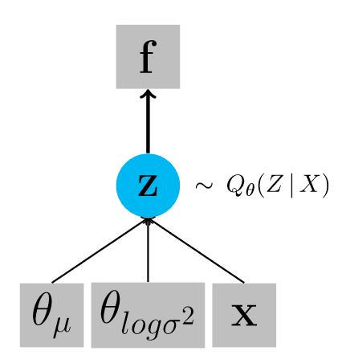
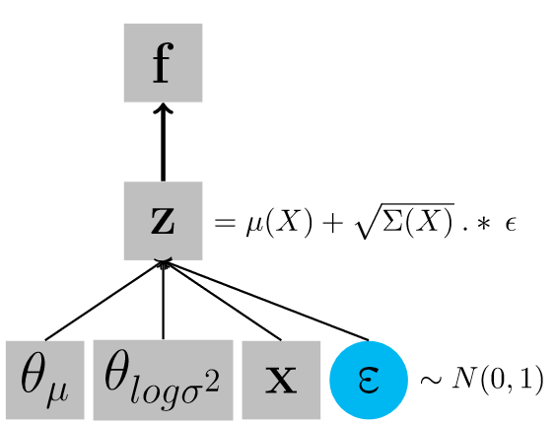
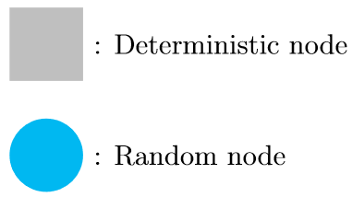
The Reparameterization Trick (part 2)
Legend
Original form
Reperameterized form
The right network uses the reparameterization trick. Back-propagation can only be applied to this network.

Slide 10
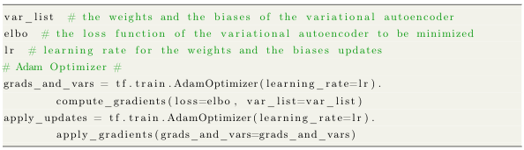
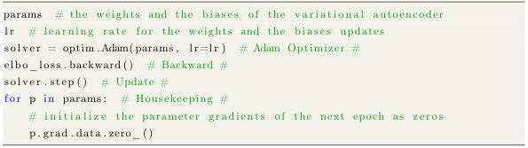
Calculating the update rules of the weights of the encoder and the decoder
TensorFlow back-propagation
PyTorch back-propagation

Slide 11
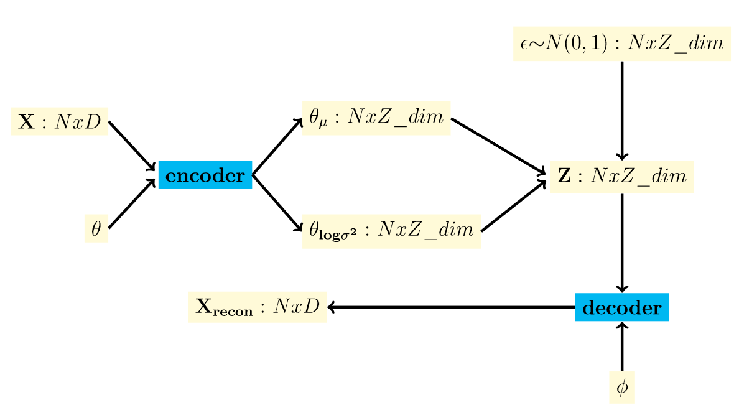
The Whole VAE Process

Slide 12
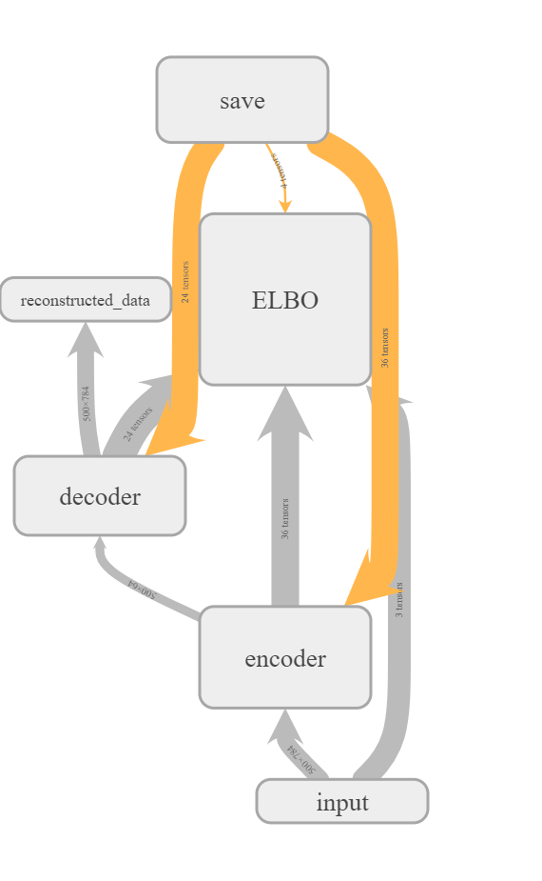
The Tensorboard
This is a visualization of the TensorFlow implementation, with TensorBoard.

Slide 13
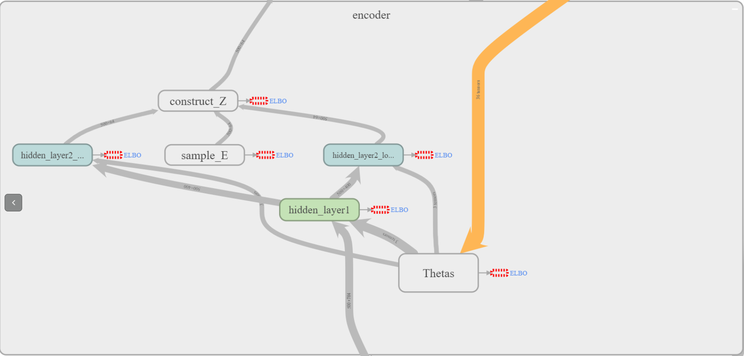
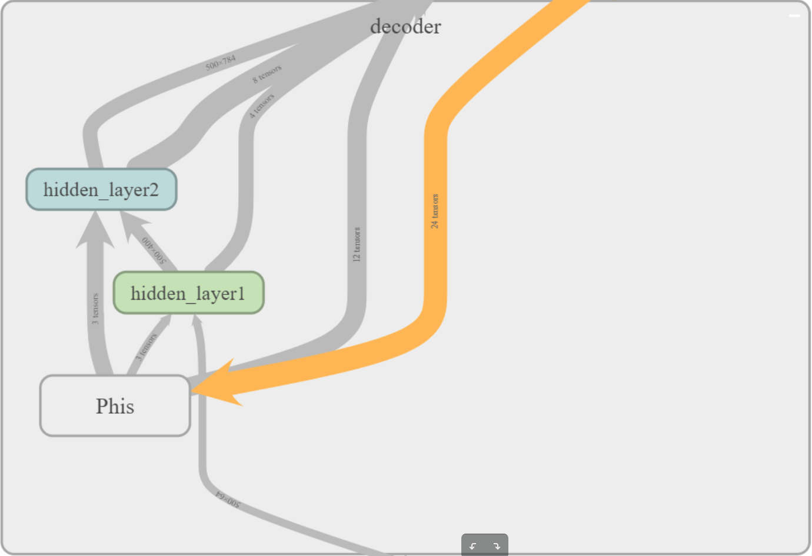
The Tensorboard (part 2)
This is an enlarged visualization of the encoder and the decoder scopes of the TensorFlow implementation, with TensorBoard.

Slide 14
K-NN Missing Values Algorithm
We use a modified K-NN algorithm for regression to predict missing values.
For each test example iteratively, select the K closest data (images) that the algorithm will take into consideration.
For the selection of the K closest distances we modify the data, in a way that the train data with missing values are not preferred. Then we calculate the distances using the Euclidean formula:
The one nearest neighbor corresponds to K=1.
We have also tested the algorithm for K=3, K=10 and K=100.
Then, we distribute softmax weights depending on the distances of the K closest data. The closest example gets the biggest weight value. Each pixel of the k-th train example is being multiplied with its corresponding weight. The weight values are assigned as follows:

Slide 15
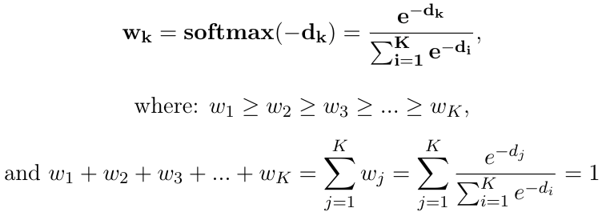
K-NN Missing Values Algorithm (part 2)
Then, we distribute softmax weights depending on the distances of the K closest data. The closest example gets the biggest weight value. Each pixel of the k-th train example is being multiplied with its corresponding weight. The weight values are assigned as follows:
where dk denotes the distance from the k-th closest train example

Slide 16
VAE Missing Values Algorithm
We can use variational autoencoders to predict missing data on training images. The main thought is to modify the VAE algorithm to keep intact the original non-missing values and change only the parts with missing values, on each iteration.
First, we construct the dataset of missing values, X_train_missing, from the original dataset X_train.

Slide 17
VAE Missing Values Algorithm (part 2)
After we have constructed the dataset with missing values, X_train_missing, we need to construct a matrix with binary values (0 or 1), which will store the information of which parts of the original images we replaced with missing values. We’ll call this matrix X_train_masked. If a pixel in an image did not get replaced, the corresponding pixel in the X_train_masked matrix will be 1. If a pixel in an image did get replaced by the "missing value", the corresponding pixel in the X_train_masked matrix will be 0.
Furthermore, we need to define the matrix that will contain the data with the predicted values of the missing pixels. We’ll call this matrix X_filled. We initialize the matrix X_filled to be the same as X_train_missing.

Slide 18
VAE Missing Values Algorithm pseudocode
for epoch = 1 to epochs
iterations = N / batch_size
for i = 0 to iterations - 1
start_index = i * batch_size
end_index = (i + 1) * batch_size
// fetch the batch data, labels and masked batch data
batch_data = X_filled(start_index:end_index, :)
batch_labels = y_train(start_index:end_index)
masked_batch_data = X_train_masked(start_index:end_index, :)
// train the batch data using the VAE process
cur_samples = train(batch_data, params)
// ".*" denotes element-wise multiplication
// The "cur_samples" will take values from the "batch_data"
// where the pixels are observed (with masked values=1)
// and will keep intact its values from the VAE training
// where the pixels are missing (with masked values=0).
cur_samples = masked_batch_data .* batch_data +
(1 - masked_batch_data) .* cur_samples
X_filled(start_index:end_index, :) = cur_samples

Slide 19
Datasets
Datasets | # TRAIN | # TEST | # VALIDATION
MNIST | 55000 | 10000 | 5000
Binarized MNIST | 50000 | 10000 | 10000
CIFAR-10 | 50000 | 10000 | -
OMNIGLOT | 390 [En] / 130 [Gr] | 360 [En] / 120 [Gr] | -
Cropped YALE Faces | 2442 | - | -
The Database of Faces | 400 | - | -
MovieLens 100k | 90570 | 9430 | -

Slide 20
Datasets
Datasets | # Classes | # Dimensions | Type of Values
MNIST | 10 | 28x28 pixels | real values in [0, 1]
Binarized MNIST | 10 | 28x28 pixels | {0, 1}
CIFAR-10 | 10 | 32x32x3 [RGB] / 32x32x1 [Grayscaled] pixels | real values in [0, 1]
OMNIGLOT | 26 [En] / 24 [Gr] | 32x32 pixels | real values in [0, 1]
Cropped YALE Faces | 38 | 168x192 pixels | real values in [0, 255]
The Database of Faces | 40 | 92x112 pixels | real values in [0, 255]
MovieLens 100k | 943 users | 1982 movies | {1, 2, 3, 4, 5}

Slide 21
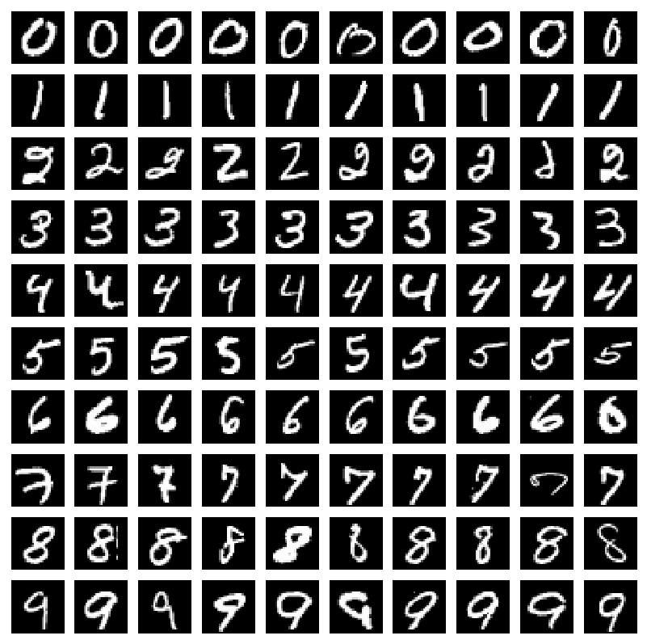
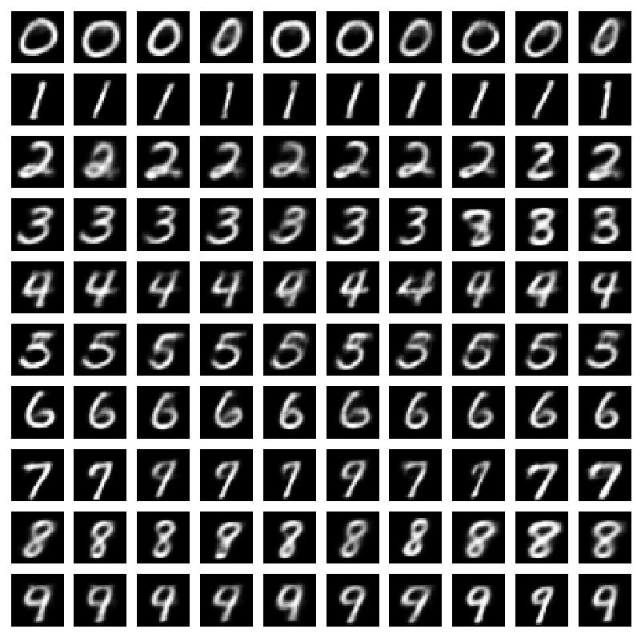
Experimental Results, VAE on the MNIST Dataset

Slide 22
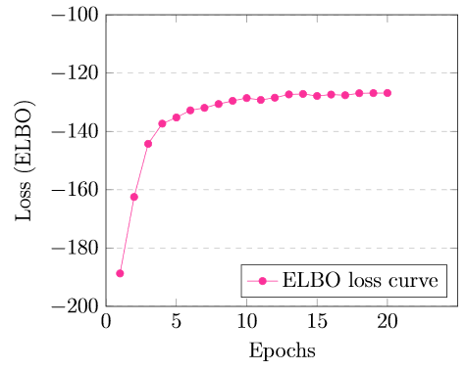
Experimental Results, VAE on the MNIST Dataset (metrics)
Metric | Value
root mean squared error (RMSE) | 0.17121448655010216
mean absolute error (MAE) | 0.07299246278044173
VAE on the MNIST dataset in TensorFlow.

Slide 23
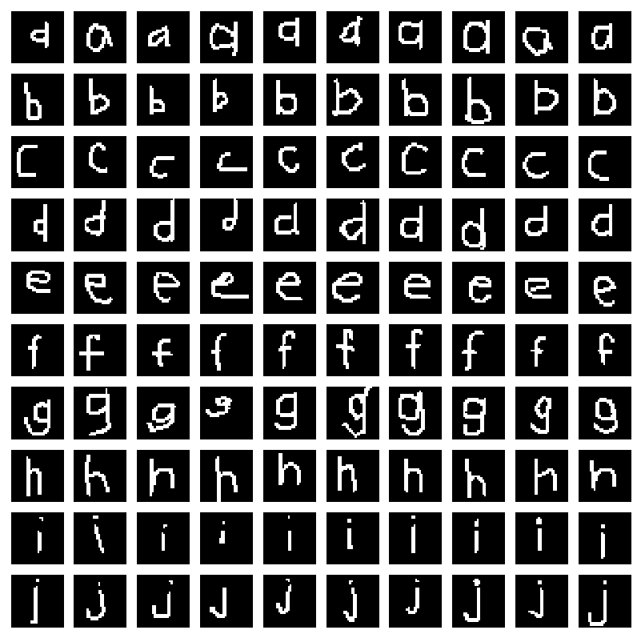
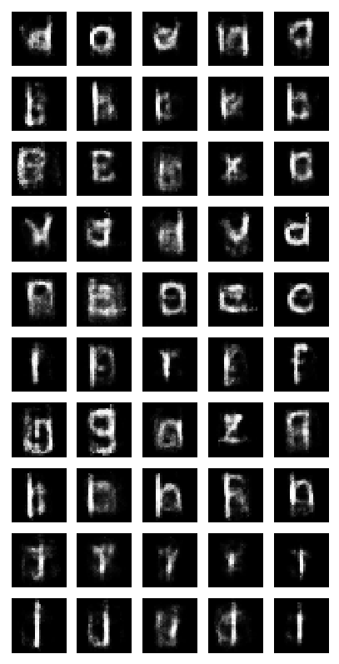
Experimental Results, VAE on the OMNIGLOT English Dataset

Slide 24
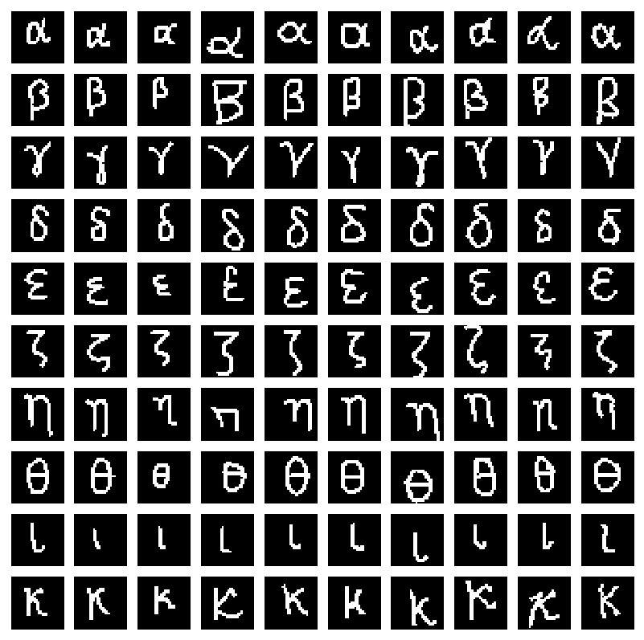
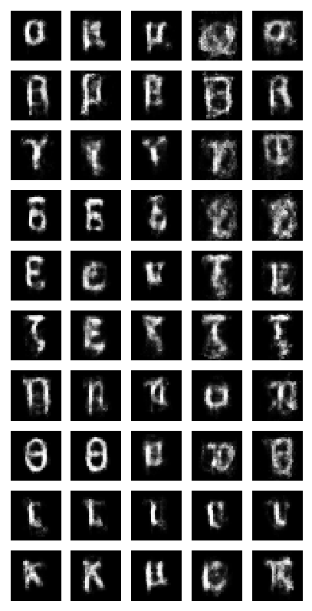
Experimental Results, VAE on the OMNIGLOT Greek Dataset

Slide 25
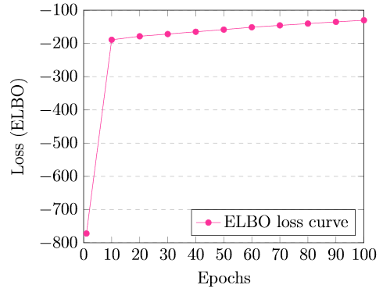
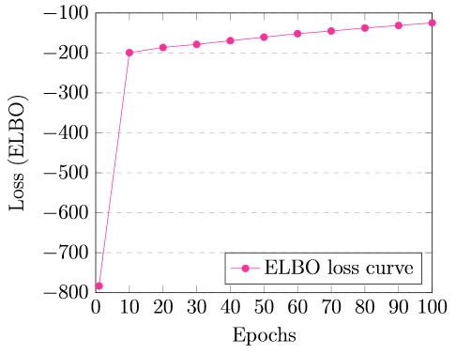
Experimental Results, VAE on the OMNIGLOT English/Greek Datasets (Metrics)
ELBO in each epoch, VAE on the OMNIGLOT English dataset in PyTorch.
ELBO in each epoch, VAE on the OMNIGLOT Greek dataset in PyTorch.
Metric | Value
root mean squared error (RMSE) | 0.2134686176531402
mean absolute error (MAE) | 0.09105986614619989
Metric | Value
root mean squared error (RMSE) | 0.20157381435292054
mean absolute error (MAE) | 0.20157381435292054

Slide 26
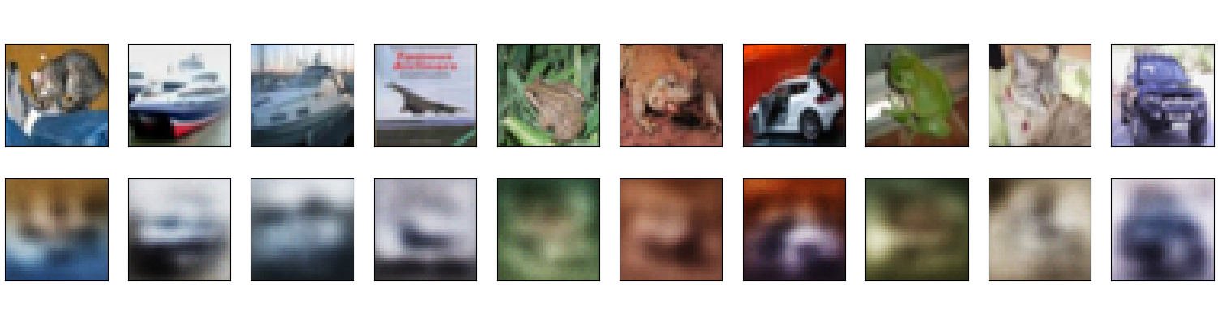
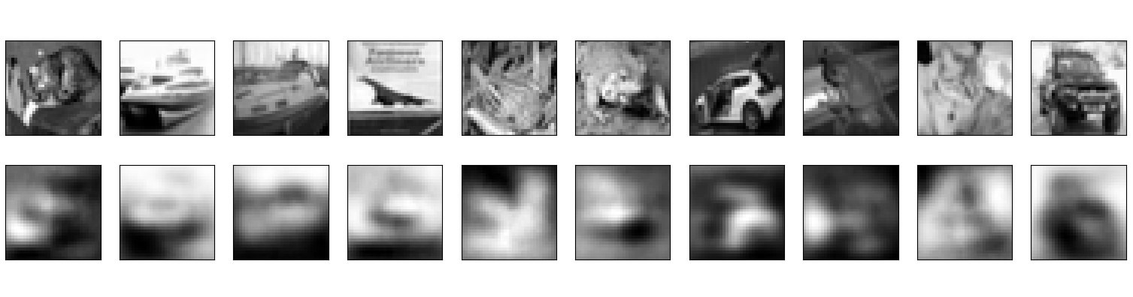
Experimental Results, VAE on the CIFAR-10 Dataset
CIFAR-10 RGB
CIFAR-10 Grayscale

Slide 27
Experimental Results, VAE on the CIFAR-10 Dataset (Metrics)
Metric | Value
last epoch loss (ELBO) | 0.6198
root mean squared error (RMSE) | 0.17352526
mean absolute error (MAE) | 0.1368697
Metric | Value
last epoch loss (ELBO) | 0.6166
root mean squared error (RMSE) | 0.14963366
mean absolute error (MAE) | 0.11517575
VAE on the CIFAR-10 RGB dataset, in Keras.
VAE on the CIFAR-10 Grayscale dataset, in Keras.

Slide 28
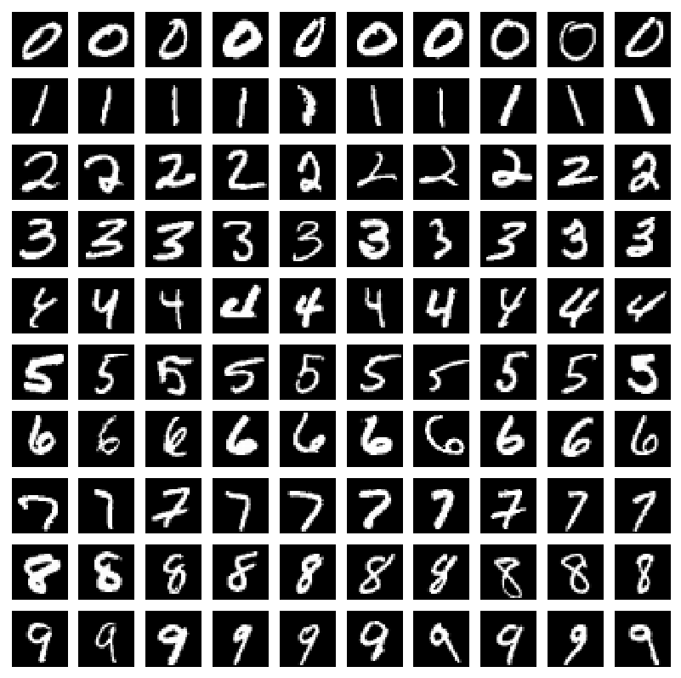
Experimental Results, Missing Values Completion Algorithm on the MNIST Dataset, Original Test Data

Slide 29
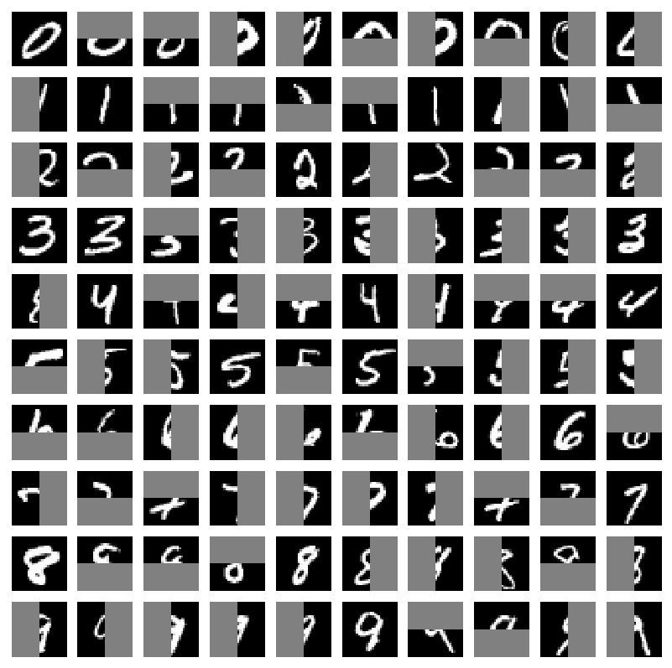
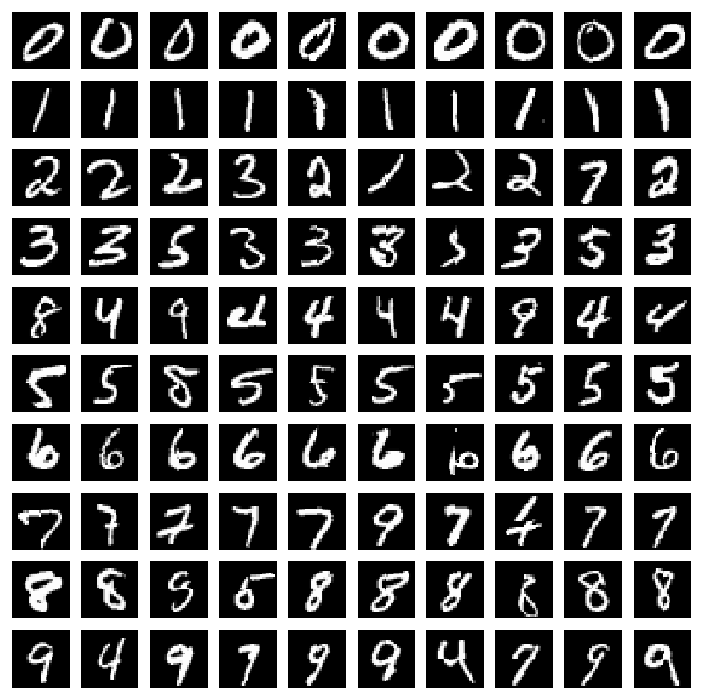
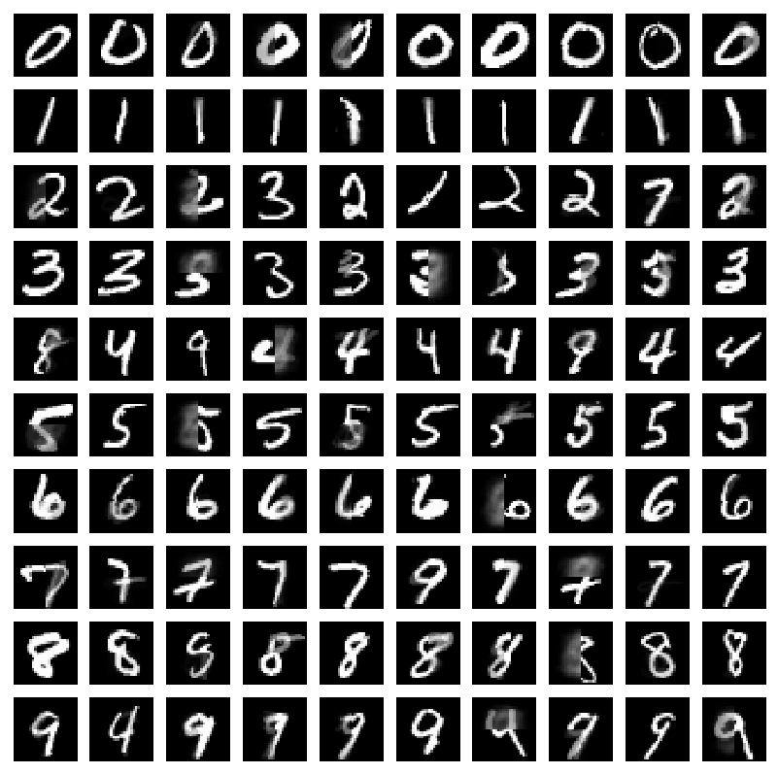
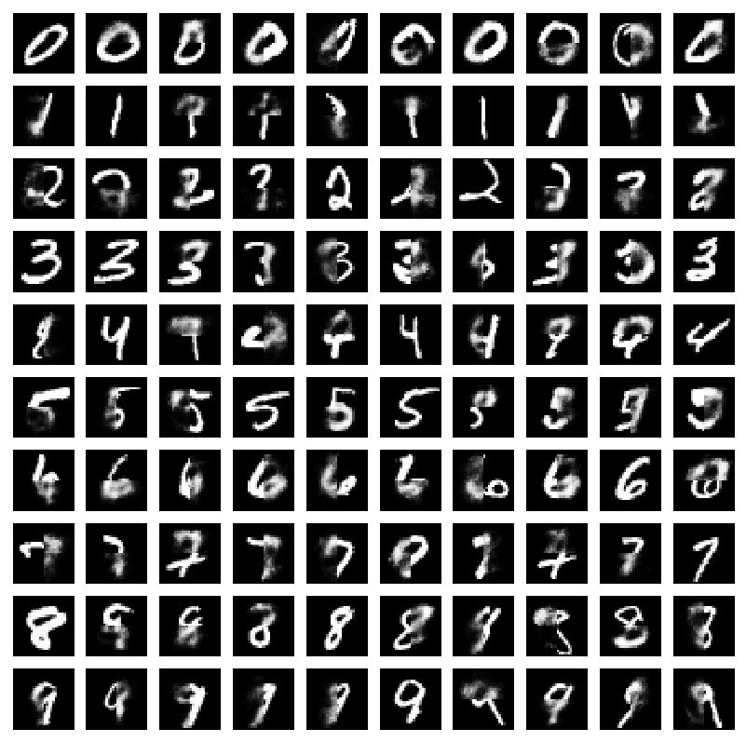
Experimental Results, Missing Values Completion Algorithms on the MNIST Dataset
Test Data with Structured Missing Values
1-NN
100-N
VAE in PyTorch Epoch 200

Slide 30
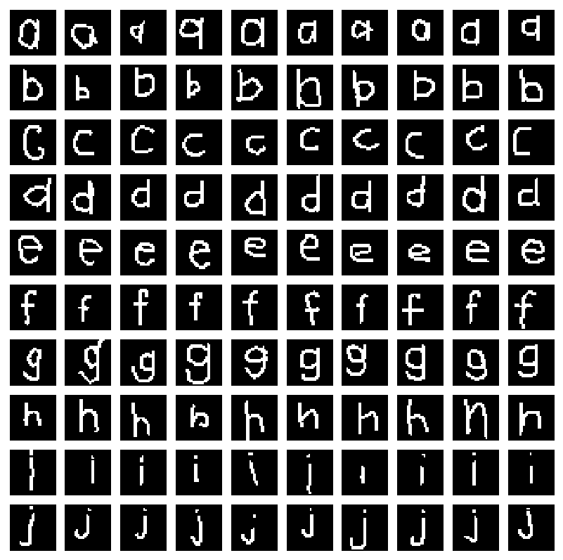
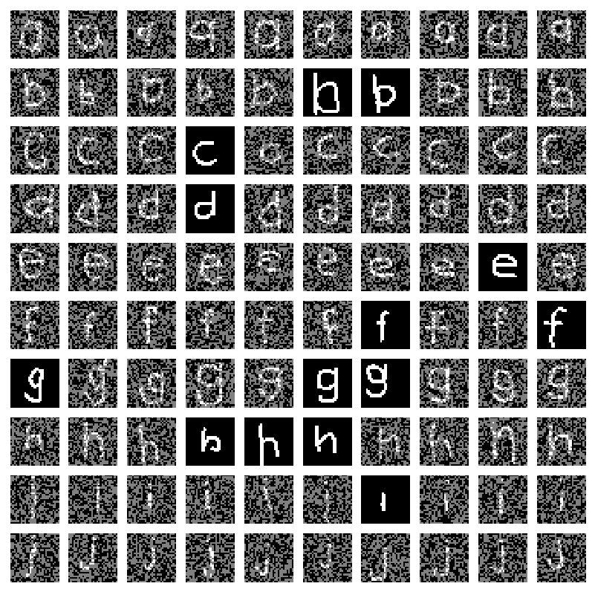
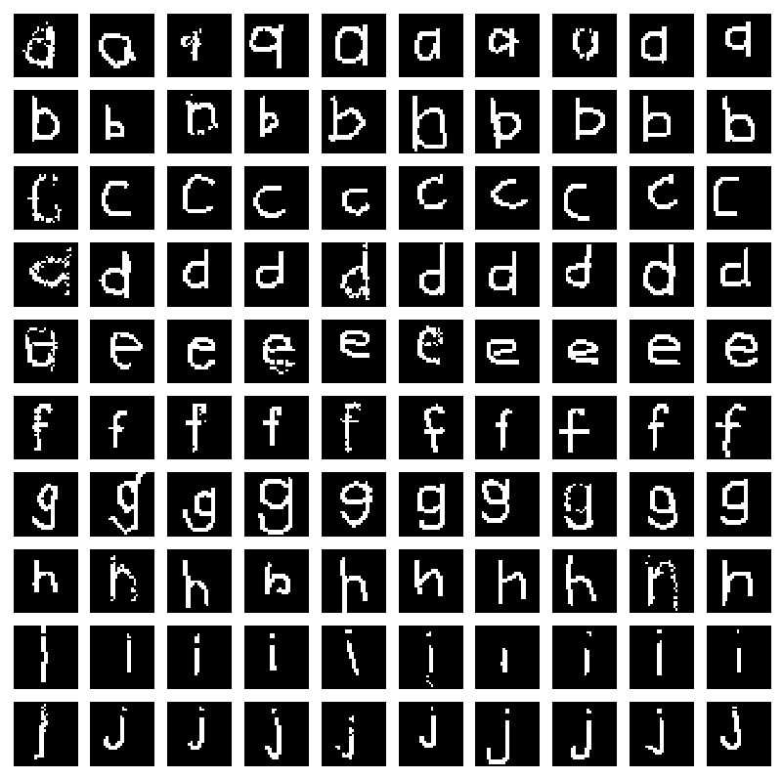
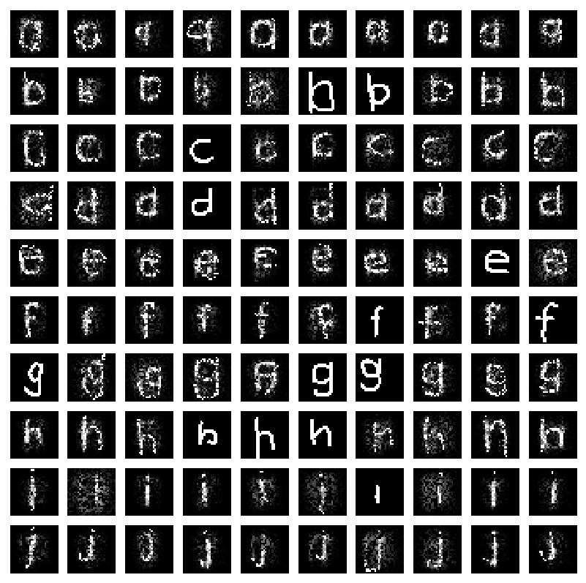
Experimental Results, Missing Values Completion Algorithms on the OMNIGLOT English Dataset
Original Data
Data with Missing at Random Values
1-N
VAE in PyTorch Epoch 100

Slide 31
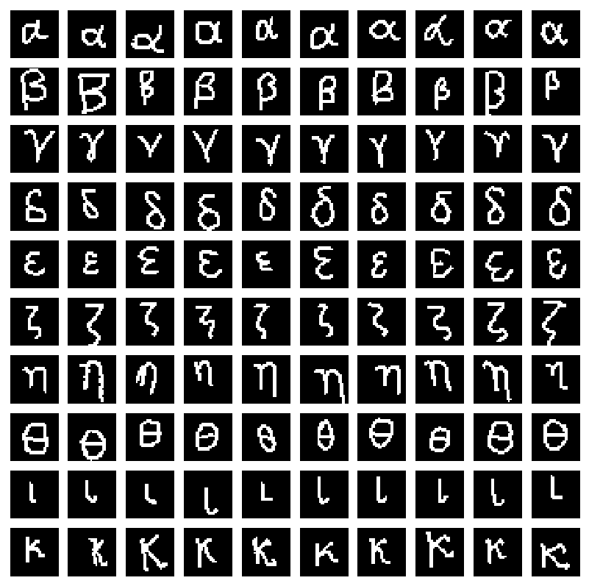
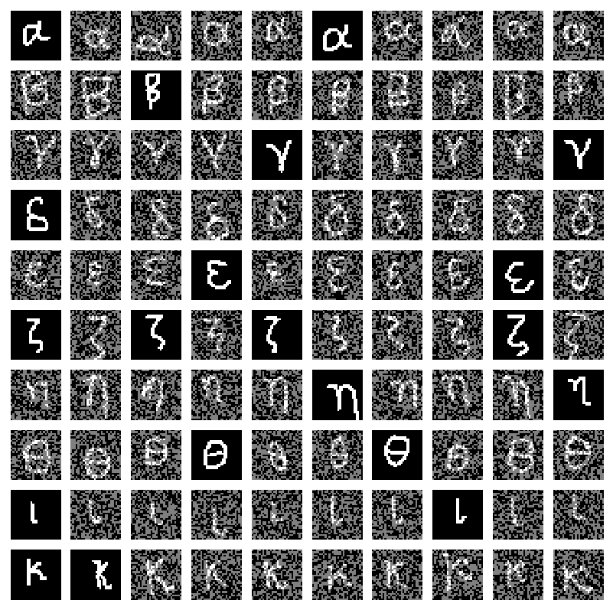
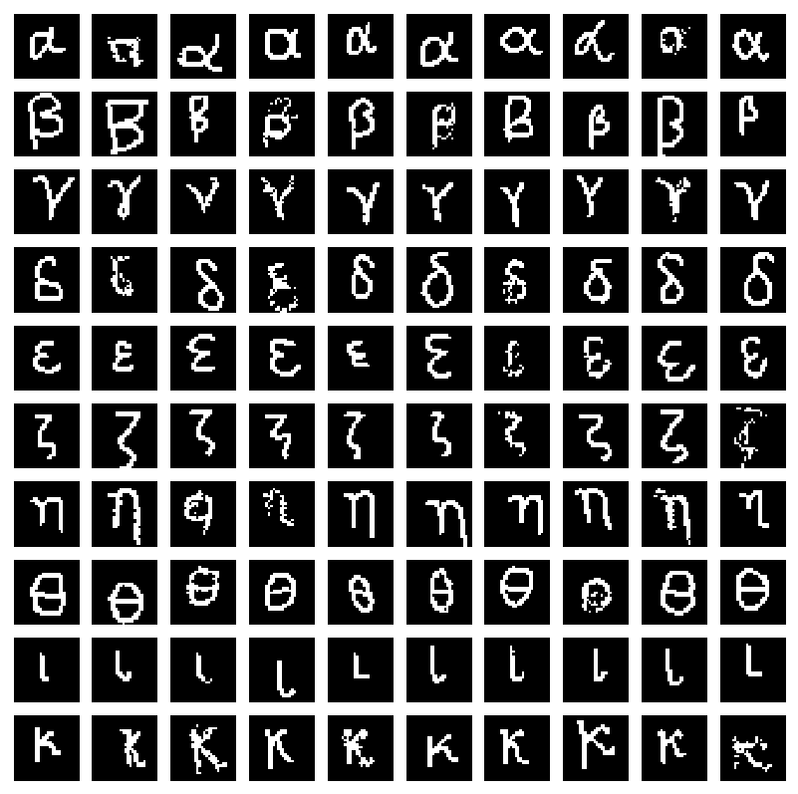
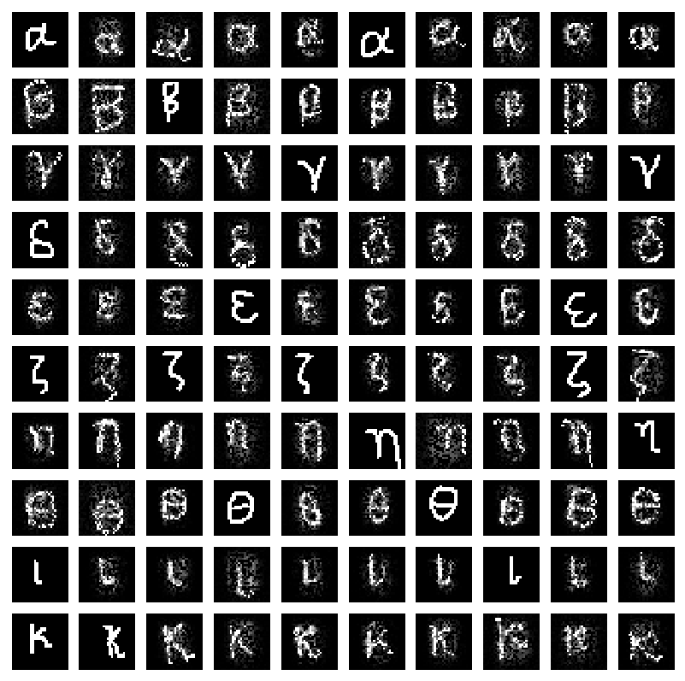
Experimental Results, Missing Values Completion Algorithms on the OMNIGLOT Greek Dataset
Original Data
Data with Missing at Random Values
1-N
VAE in PyTorch Epoch 100

Slide 32
Experimental Results, VAE Missing Values Completion Algorithms (Metrics)
Method | RMSE | MAE | Time
1-NN | 0.171569 | 0.0406822 | 190.26 sec
100-NN | 0.148223 | 0.0396628 | 233.19 sec
VAE | 0.168031 | 0.0499518 | 178.09 sec
Missing Values completion algorithms on the MNIST dataset.
Method | RMSE | MAE | Time
1-NN | 0.089003 | 0.161780 | 8.64 sec
VAE | 0.160895 | 0.050487 | 254.48 sec
Method | RMSE | MAE | Time
1-NN | 0.084689 | 0.1663 | 9.37 sec
VAE | 0.162737 | 0.052432 | 245.66 sec
Missing Values completion algorithms on the OMNIGLOT English dataset.
Missing Values completion algorithms on the OMNIGLOT Greek dataset.

Slide 33
K-NN vs VAE Missing Values Completion Algorithm on the MovieLens Dataset
We have run both K-NN and VAE in TensorFlow Missing Values algorithms on the MovieLens Dataset
and compared the predicted ratings. The results are the following:
Metric | Value
root mean squared error (RMSE) | 0.0803184360998
mean absolute error (MAE) | 0.0209178842034
match percentage | 91.2514516501 %
Method | Mean Rating
VAE in PyTorch | 1.60717332671
K-NN Missing Values algorithm | 1.61095209334

Slide 34
THANK YOU!

